Slide 1


The Story of DevOps
Vahid Ashrafian – Pichak Co.

Slide 2
Outline
Story of Pichak
Story of DevOps
Your Story

Slide 3
Story of Pichak

Slide 4
Story of Pichak
Story of Pichak toward making software, faster, cheaper and good!
Technical
Culture

Slide 5



Slide 6
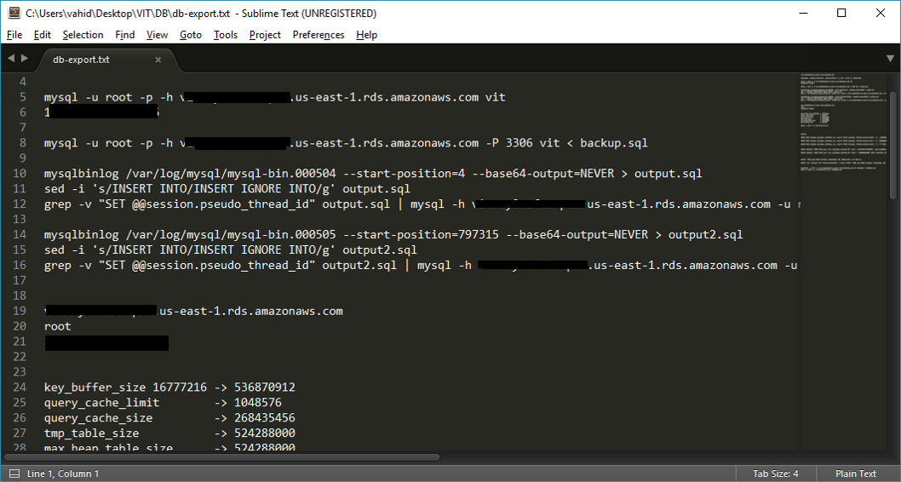
Manuals

Slide 7
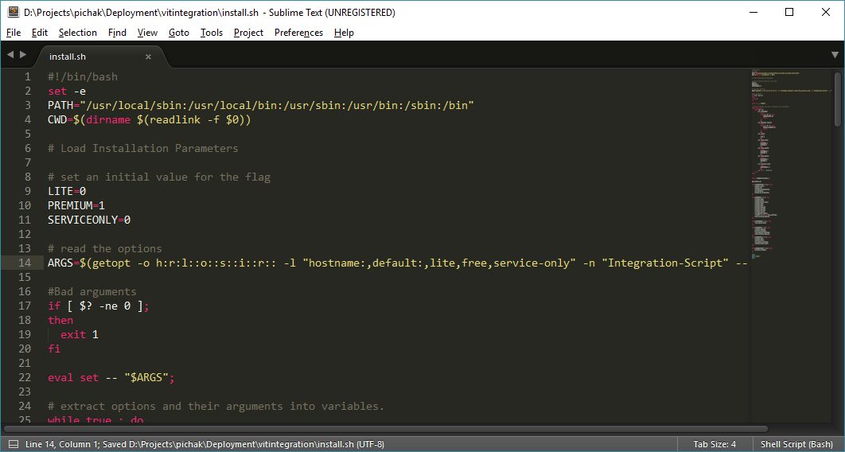
Bash Scripts

Slide 8
Bash Scripts (Pro’s)
Easy to use
Easy to learn
Easy to change
We can use source control (Git)

Slide 9
Bash Scripts (Con’s)
Low Speed
Unorganized

Slide 10

Juju?

Slide 11

Provides a modeling language for users that abstracts the specifics of operating complex big software topologies

Slide 12

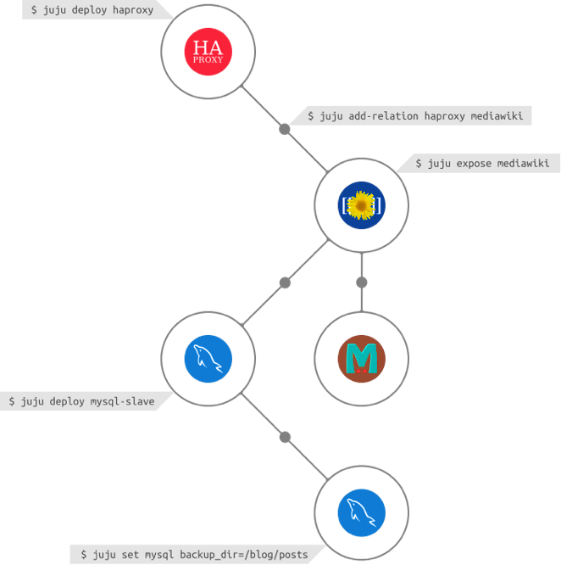

Slide 13
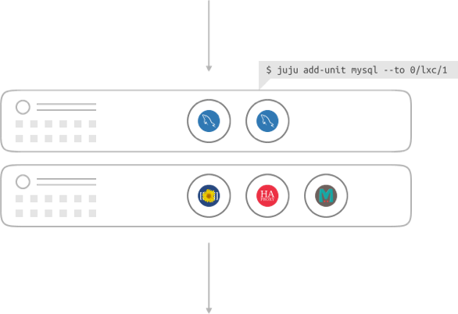

Slide 14

Containers

Slide 16
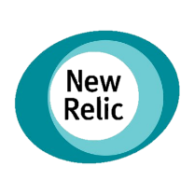









Monitoring
Purchase
Analytics
BL
Alert

Slide 17
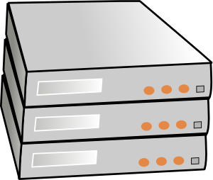





Continues Delivery & Deployment
Notes:
What’s left? Workflow management

Slide 18
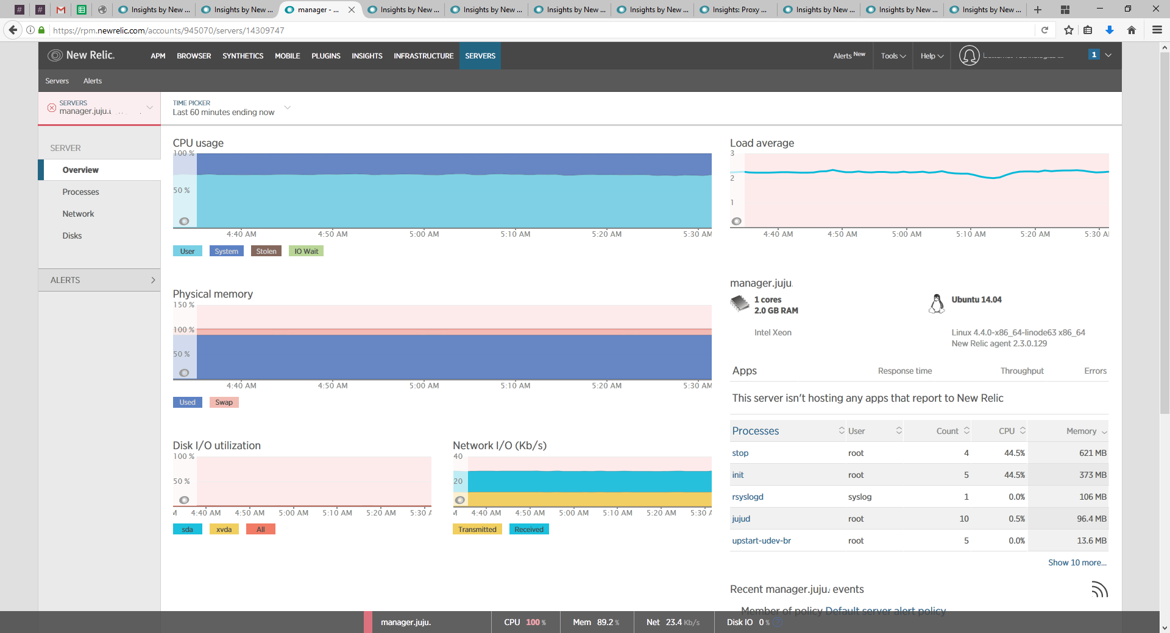
New Relic Servers

Slide 19

Griffin
Gatherer
Runner
Reporter
Cleaner
Checker
Notes:
Pluggable gatherer

Slide 20
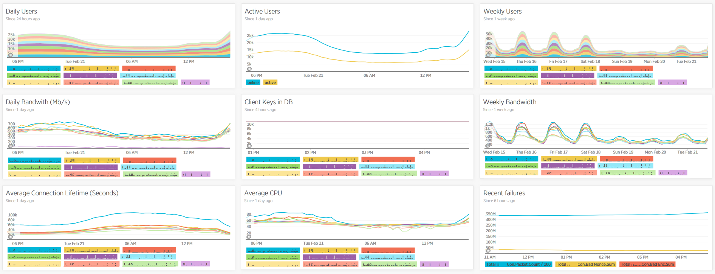
New Relic Insights

Slide 21
From Dev to Ops
Amirs
Vahid
Soroush
Hasan

Slide 22


Slide 24


Slide 25


Slide 26
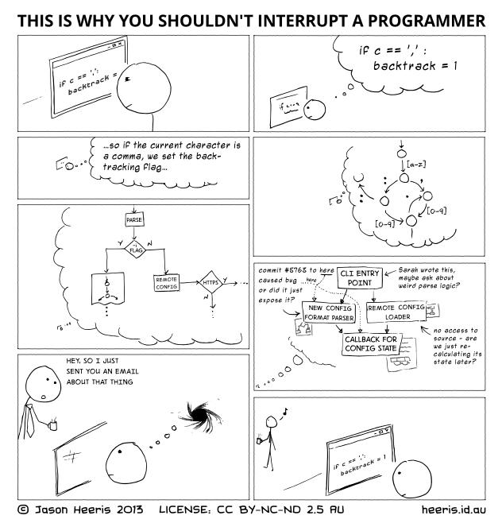
Interrupts!

Slide 27
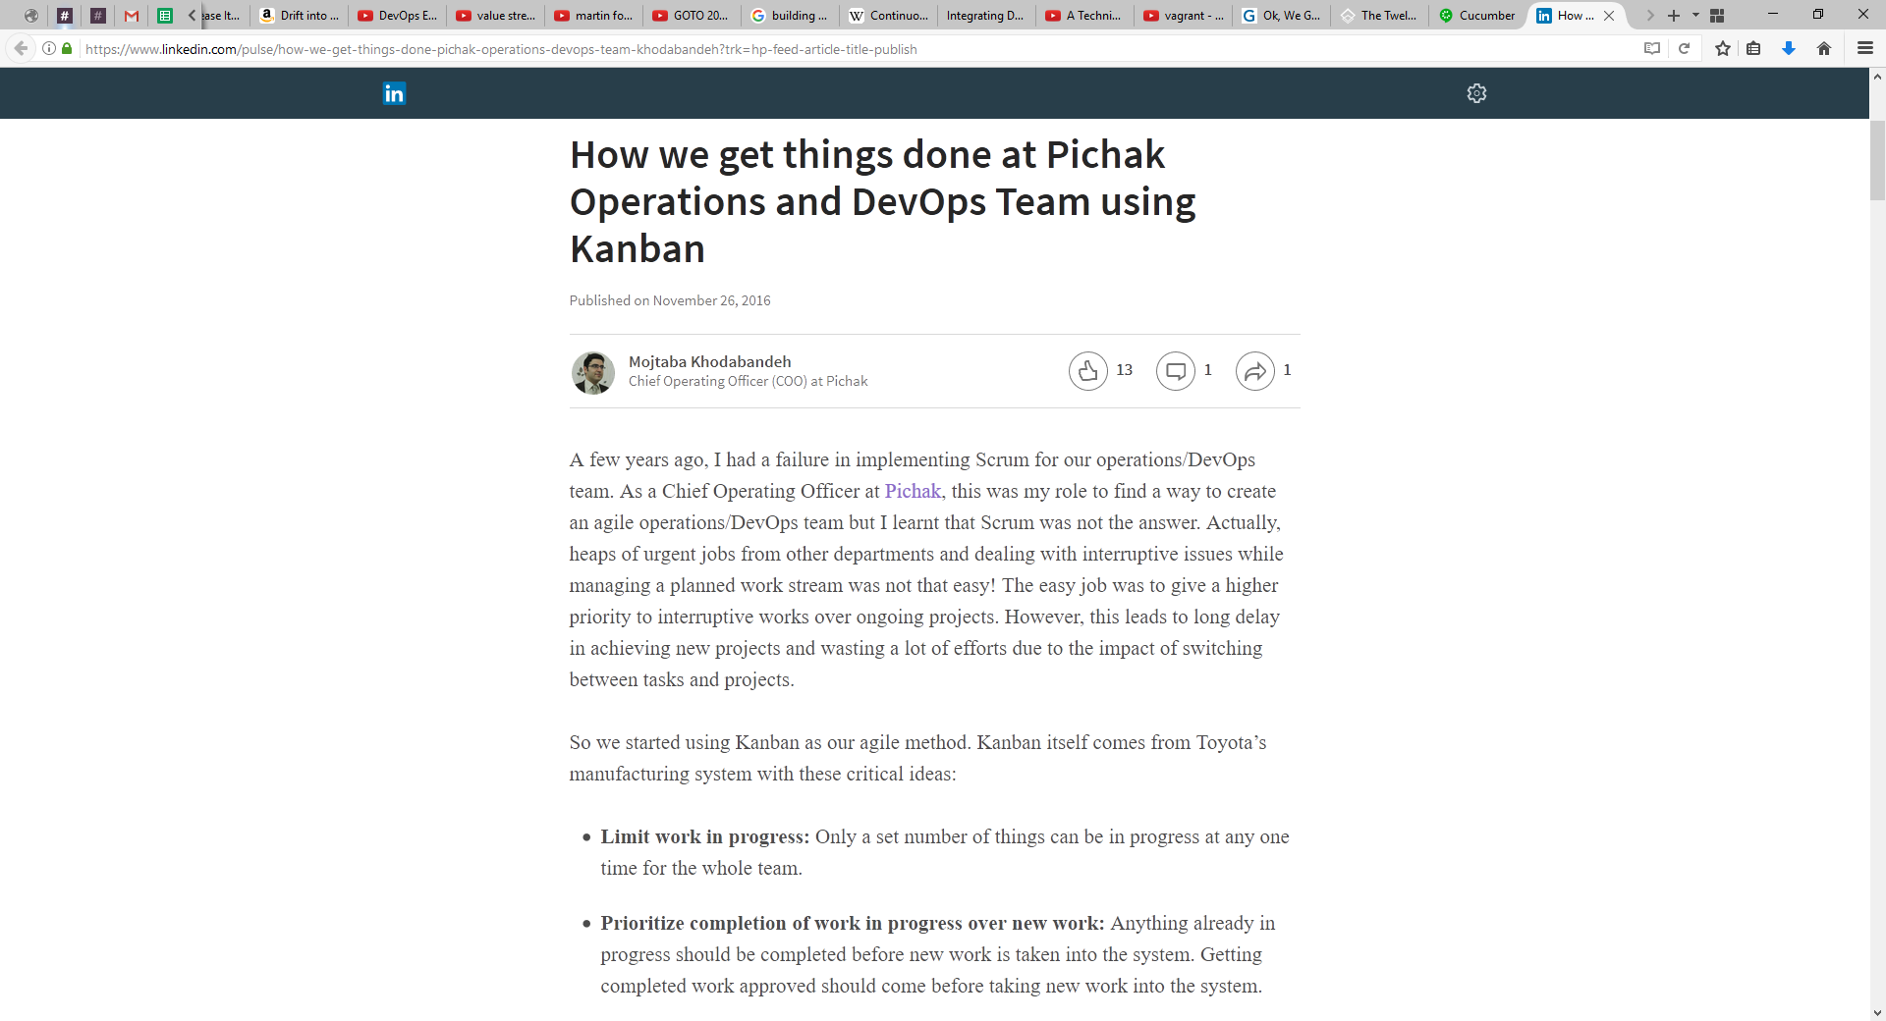
We Need to Change

Slide 28
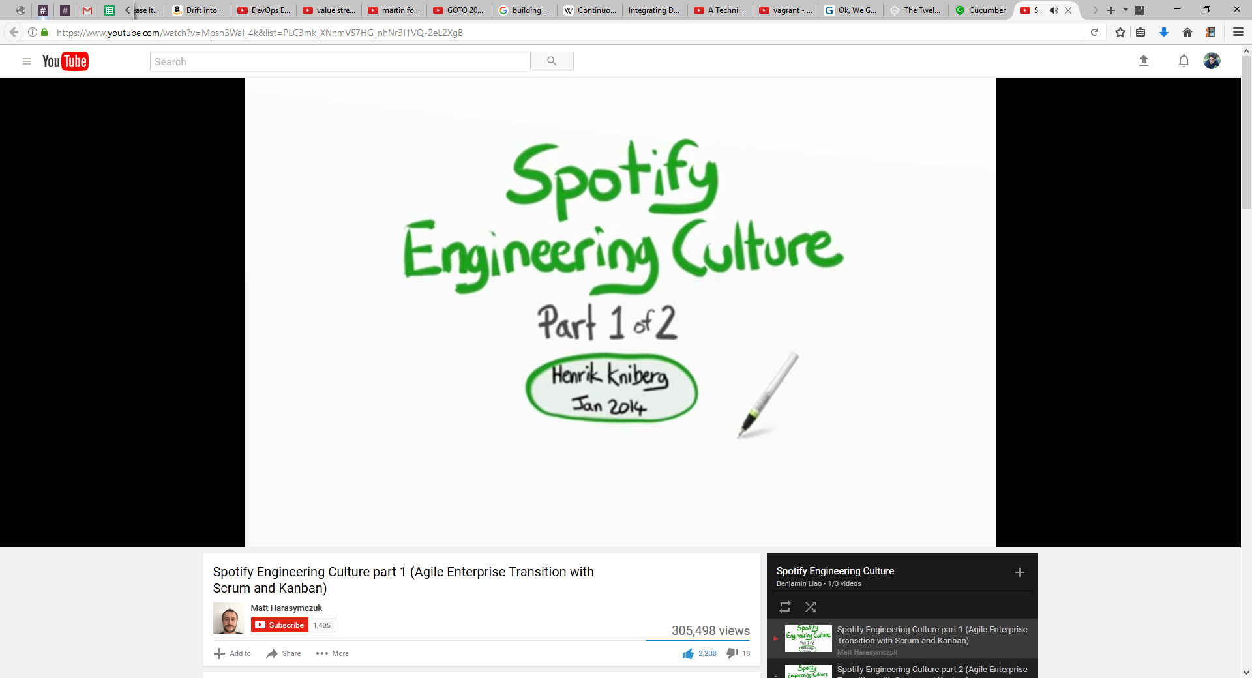
Spotify Culture

Slide 29
How we get things done at Pichak DevOps Team
Basic Ideas of Kanban
Limit work in progress
Prioritize completion of work in progress over new work
Manage the flow of work through the system
Visualize the workflow

Slide 30
Request Channels
Internal
External

Slide 31
Request Channels
Incidents
Tasks
Stories

Slide 32
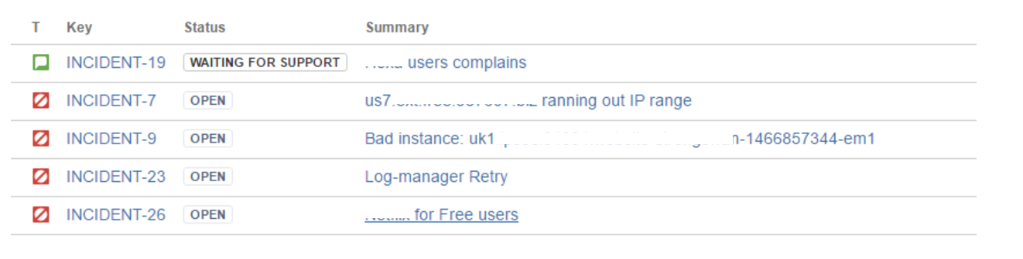
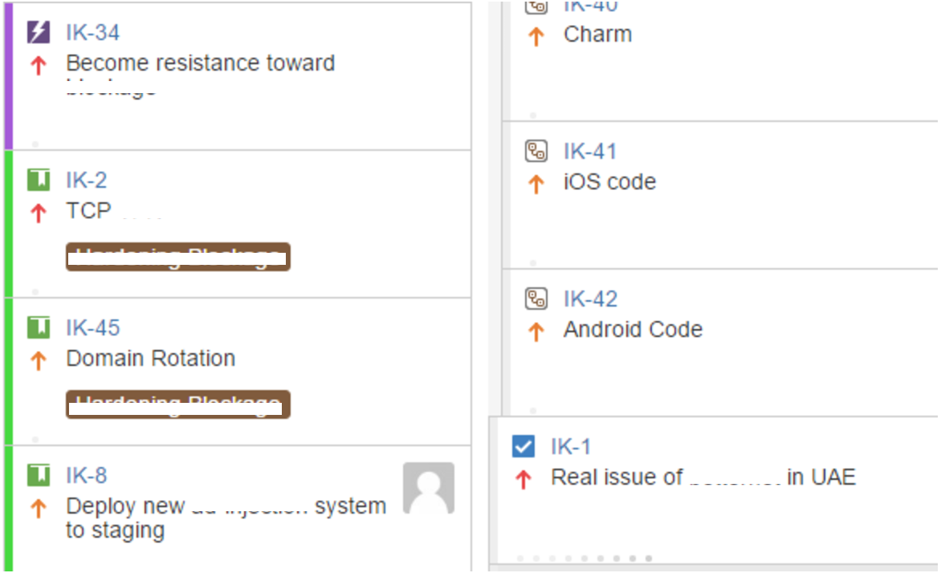
Request Channels
Incidents
Tasks
Stories
Notes:
Time for incidents

Slide 34
Story of DevOps

Slide 35

So I wrote the code, now what?
Notes:
Just writing the code From Development to Release
From RUP to Agile
Change management

Slide 36

DevOps
Notes:
Start from development to release and operation (maintenance) and also culture
Lower the cost of change

Slide 37







DevOps

Slide 38
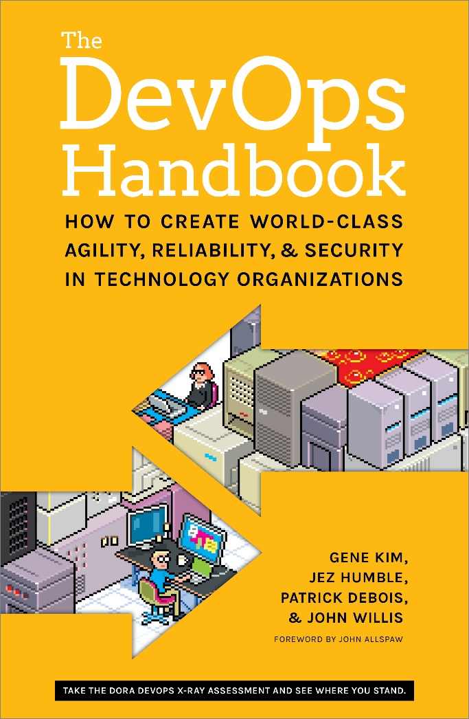
Three Ways of DevOps
The First Way: Accelerate Flow
The Second Way: Amplify Feedback Loops
The Third Way: Accelerate Learning
Notes:
Lets start from scratch All steps from starting point

Slide 39
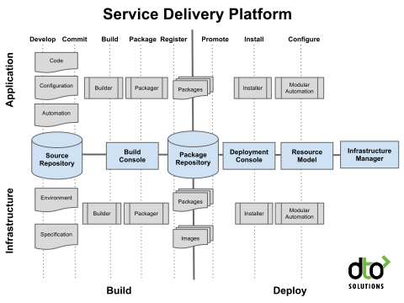
The First Way: Accelerate Flow
Continues Delivery & Deployment
Small and Frequent Changes
Fast and Frequent Deployment
Notes:
Lets start from scratch One step Build and Deployment Automation

Slide 40
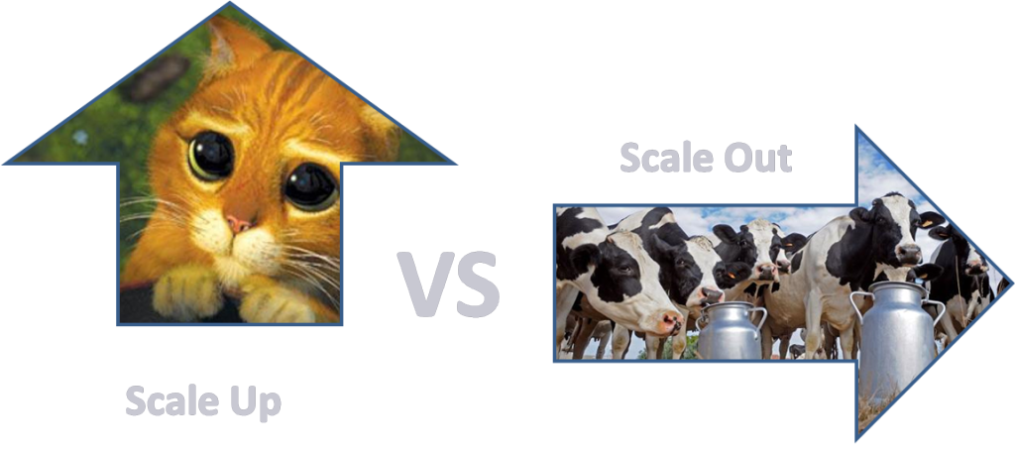
The First Way: Accelerate Flow
Pets vs Cattle

Slide 41

Microservices

Slide 42

The First Way: Accelerate Flow
Two-Pizza Team
From Idea to Release

Slide 43
The Second Way: Amplify Feedback Loops
Goals:
Right to Left
Find and Fix Fast
Shorten and Amplify Feedback

Slide 44
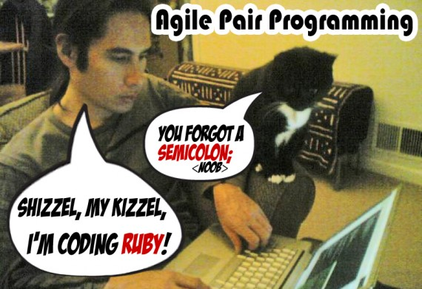
The Second Way: Amplify Feedback Loops
Fast Feedback
Peer review and pairing
Contingency
Design for failure
Feedback loops
Developer managed service

Slide 45
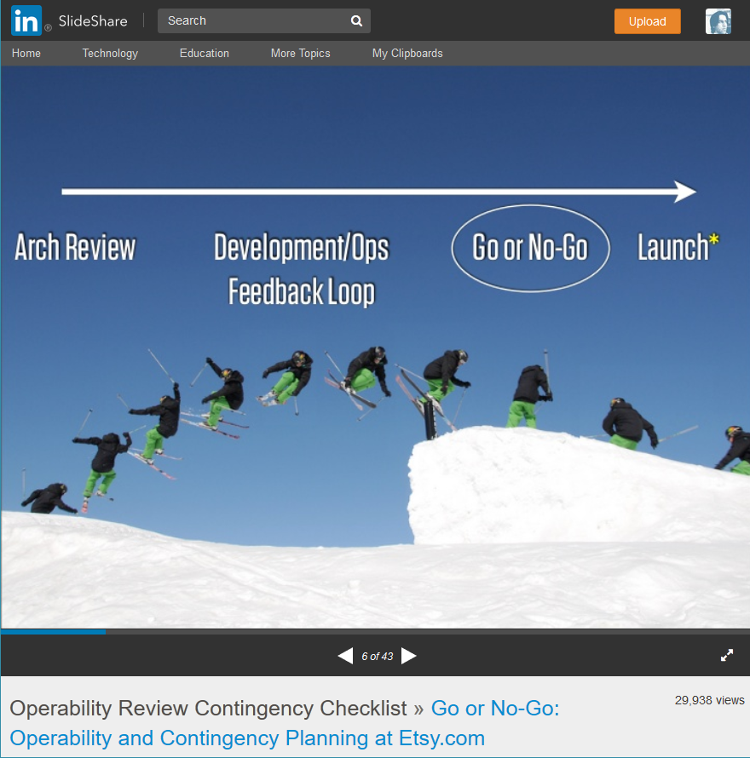
The Second Way: Amplify Feedback Loops
Etsy Operability Review Contingency Checklist:
When will it be launched
Who is launching it
Has it been in production yet
Can it be dark, feature or percentage launched
Is it new infrastructure
Has an on off switch
All parties available at launch time

Slide 46

The Second Way: Amplify Feedback Loops
Deploys – Upgrading Live Services
Canary
Rolling upgrades
Blue green deploy
Dark deploys
Toggling feature
A/B testing

Slide 47
The Second Way: Amplify Feedback Loops
Monitoring : Looking at Service Stack
Business indicators
Application indicators
Infrastructure indicators
User based indicators
Deployment indicators

Slide 48
The Second Way: Amplify Feedback Loops
Monitoring : Google’s Four Golden Signals
Latency
Traffic
Errors
Saturation
Notes:
Do we need to monitor everything?

Slide 49
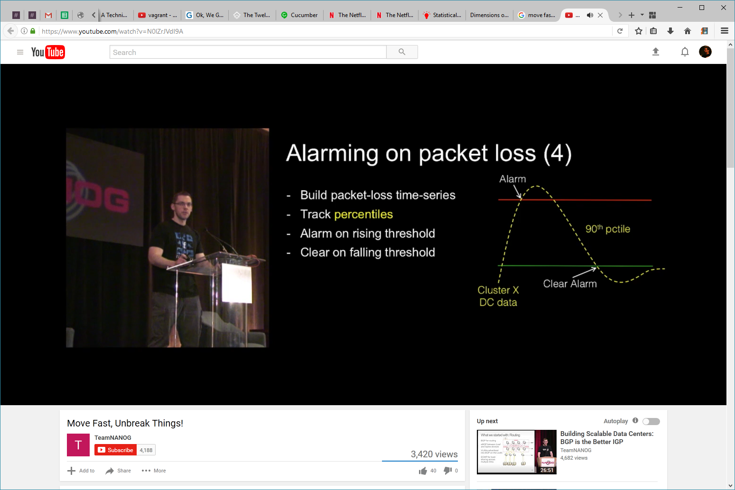
The Second Way: Amplify Feedback Loops

Slide 50
The Second Way: Amplify Feedback Loops
Design for failure
Notes:
100% reliability myth

Slide 51


The Second Way: Amplify Feedback Loops
Design for failure
The Netflix Simian Army
Chaos Monkey
Latency Monkey
Conformity Monkey
Doctor Monkey
Janitor Monkey
Security Monkey
10-18 Monkey
Chaos Gorilla
Notes:
100% reliability myth

Slide 52
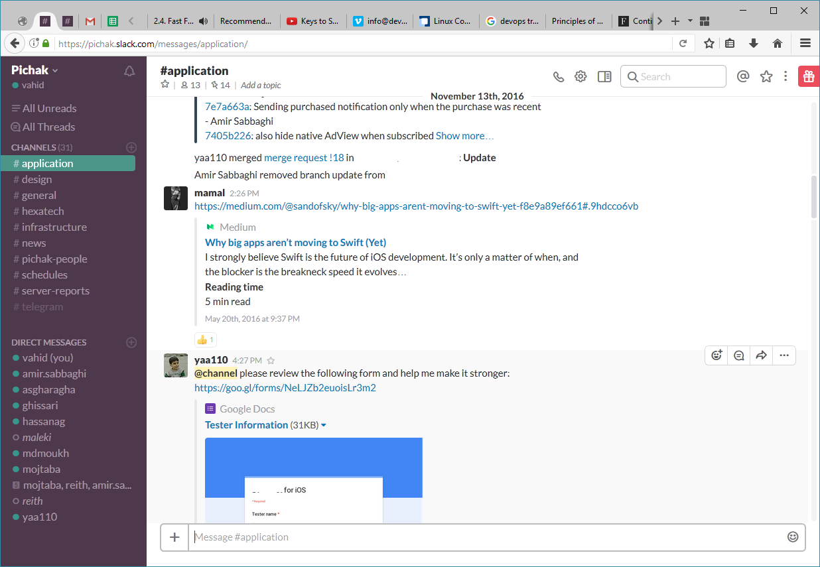
The Second Way: Amplify Feedback Loops
ChatOps

Slide 53
The Third Way: Accelerate Learning
Learning Organizations
Communication
Blameless Culture

Slide 54
The Third Way: Accelerate Learning
Learning Organizations
Psychological safety
Appreciation of difference
Openness to new ideas
Time for reflection
Systematic knowledge sharing
Education and experiment
Reinforced learning

Slide 55
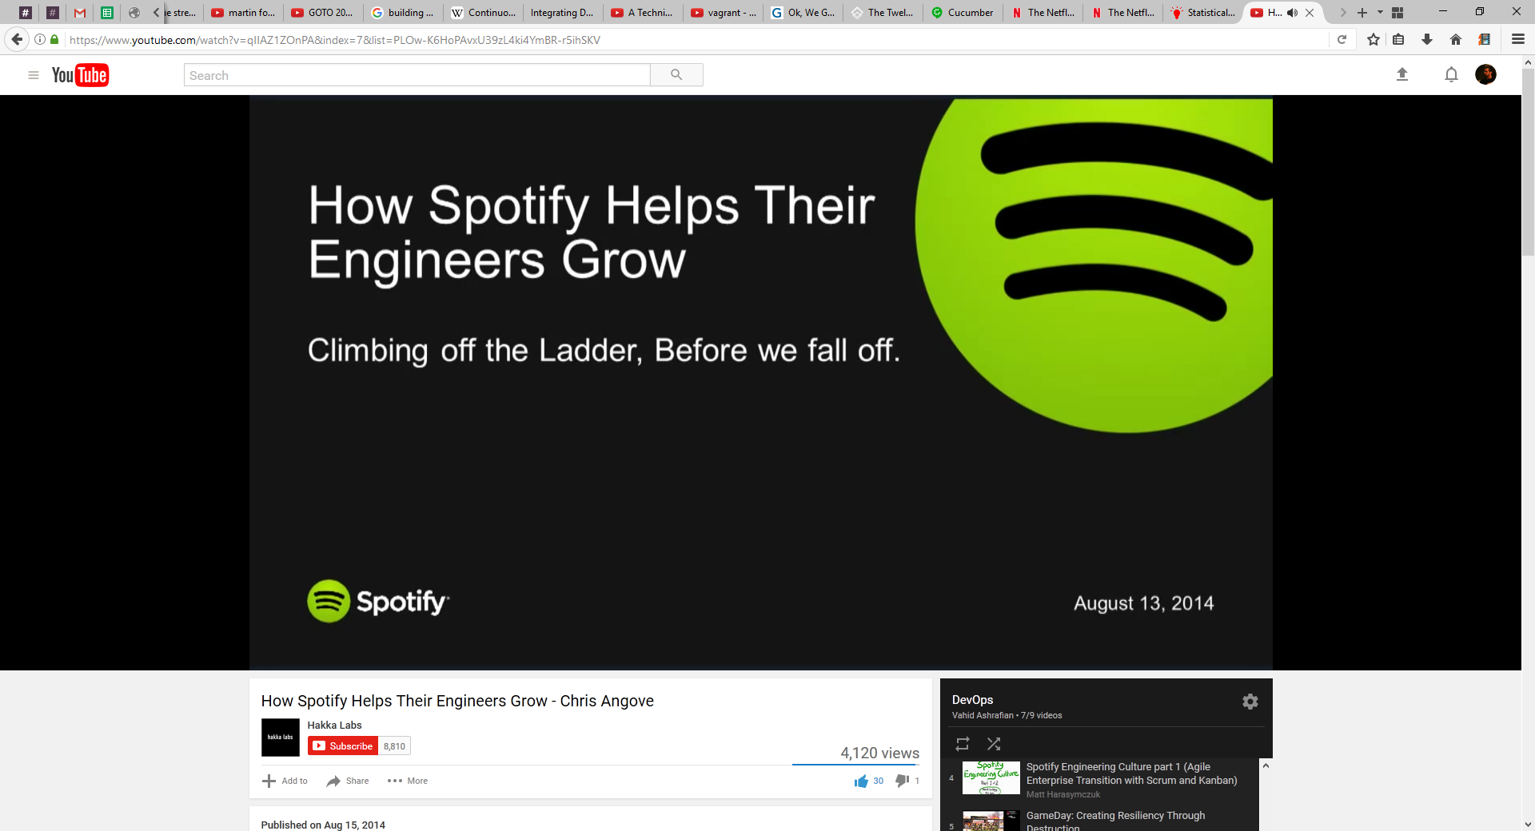
The Third Way: Accelerate Learning
Learning Organizations
Communication

Slide 56
The Third Way: Accelerate Learning
Blameless Culture
A blameless culture believes that systems are NOT inherently safe and humans do the best they can to keep them running.
Notes:
Blameless Postmortem

Slide 57
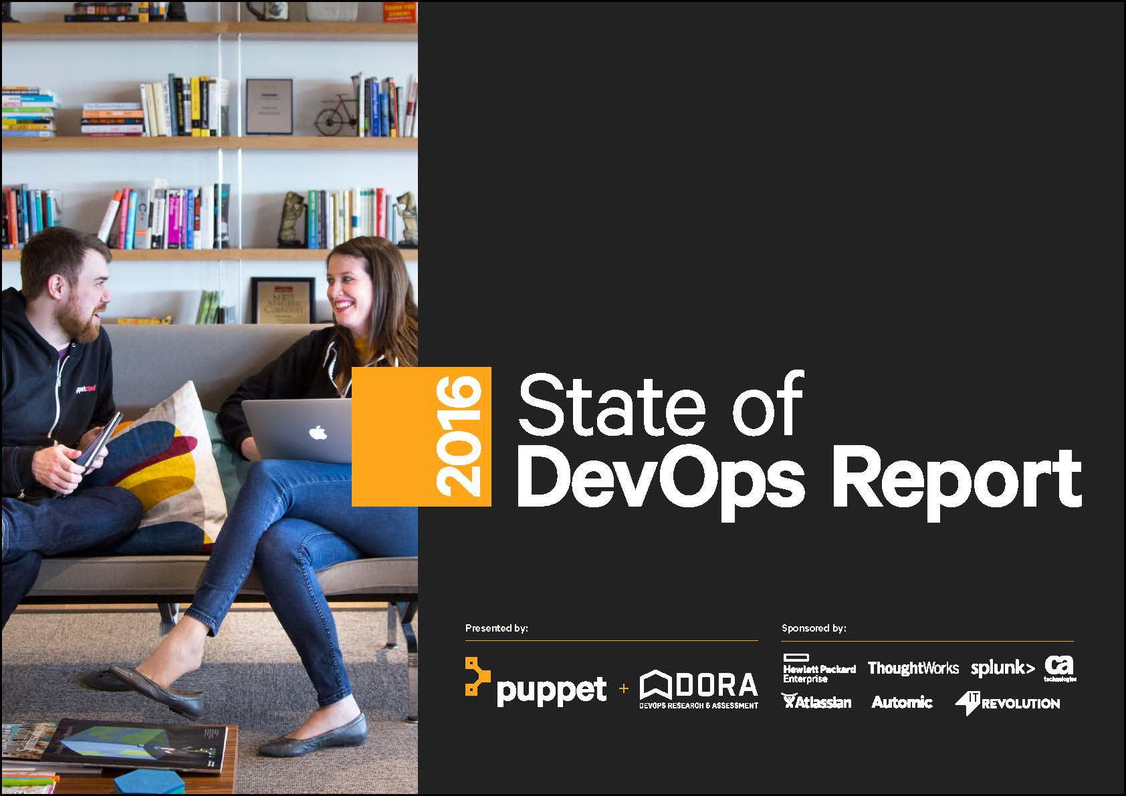
High-performing organizations

Slide 58
High-performing organizations
Deploy 200 times
2,555 times faster lead times
recover 24 times faster
three times lower change failure rates

Slide 59

Your Story

Slide 60
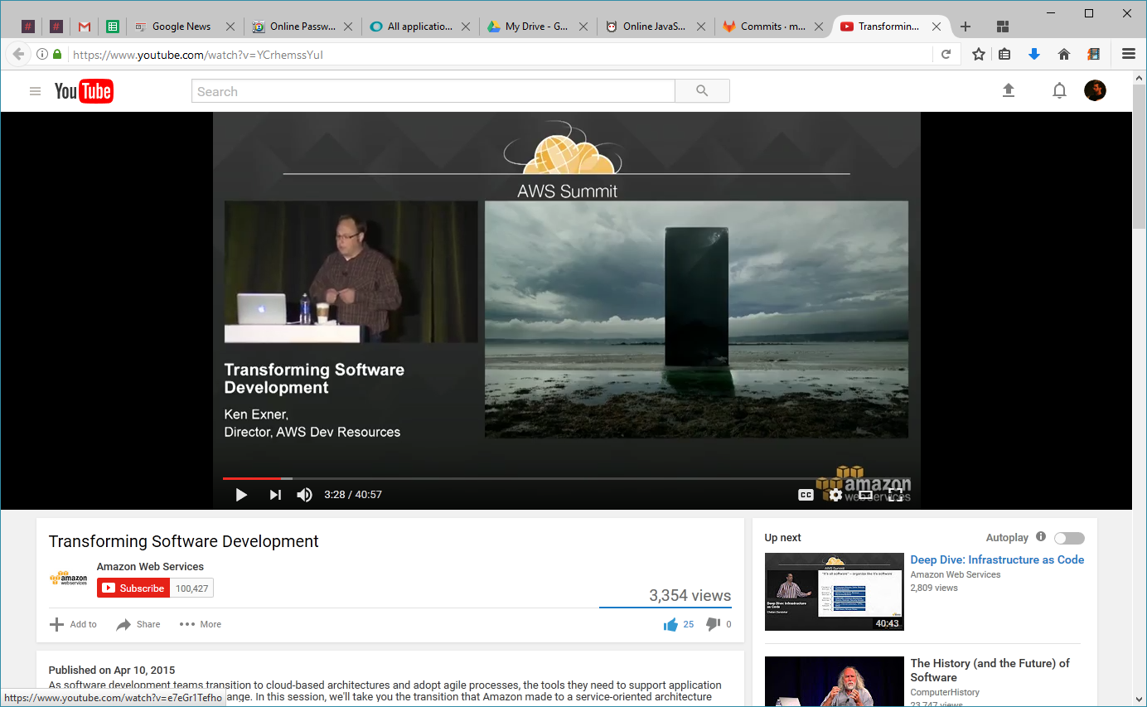
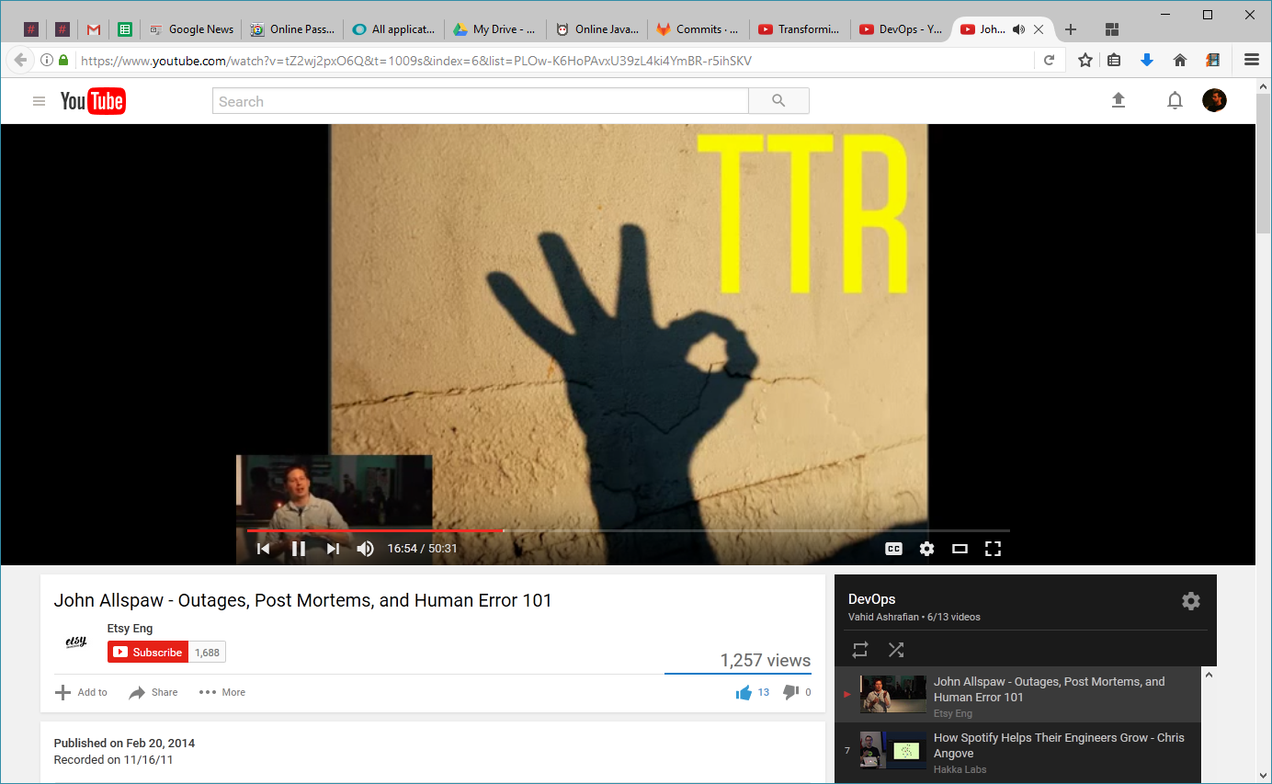
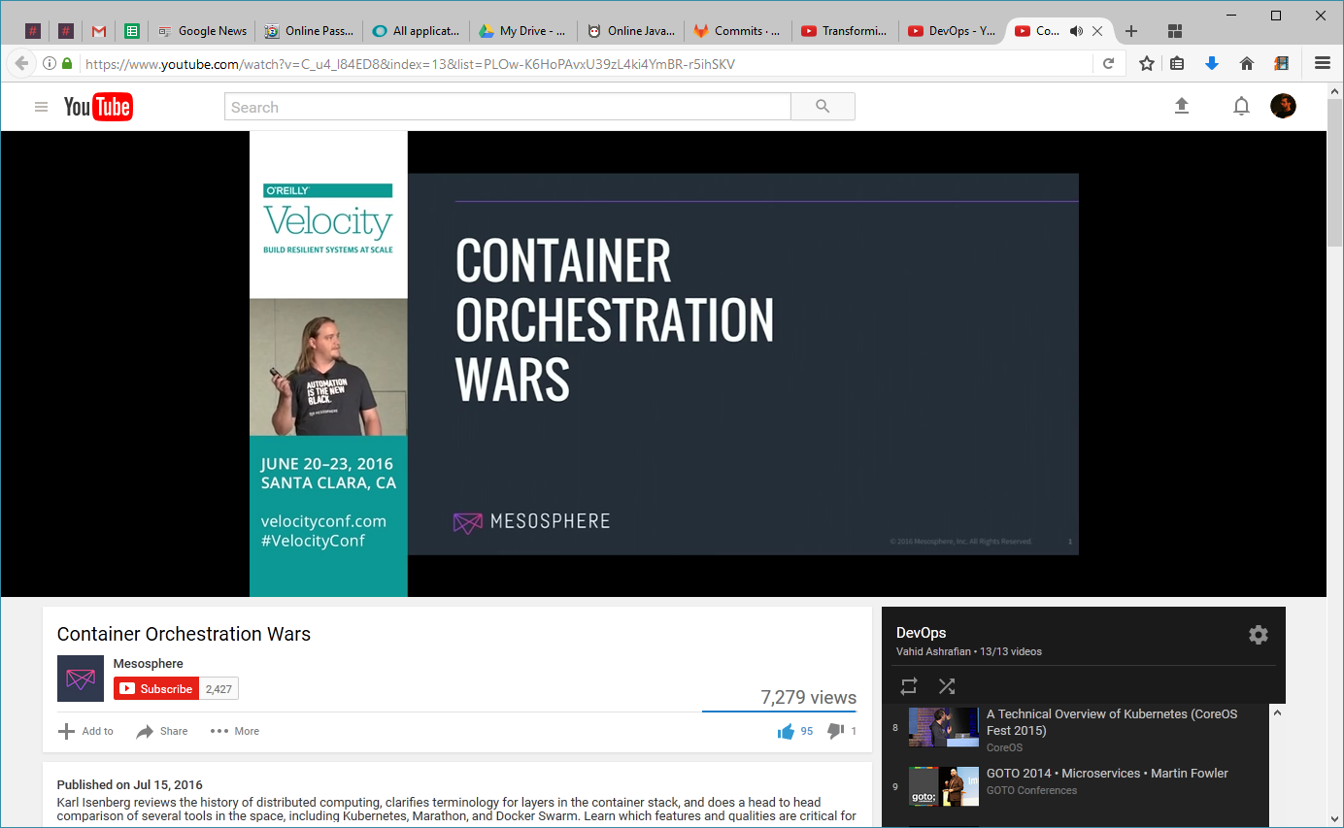
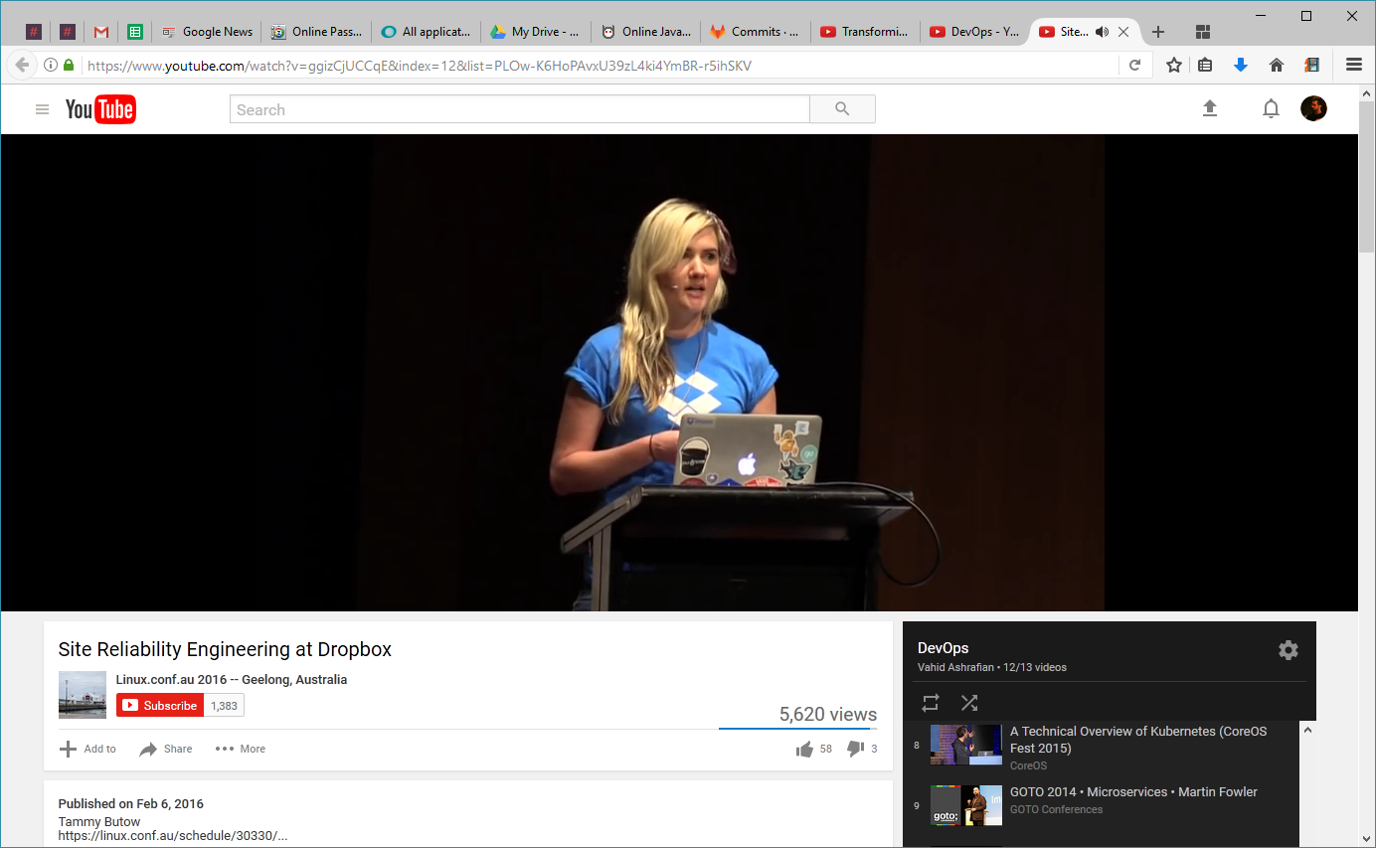
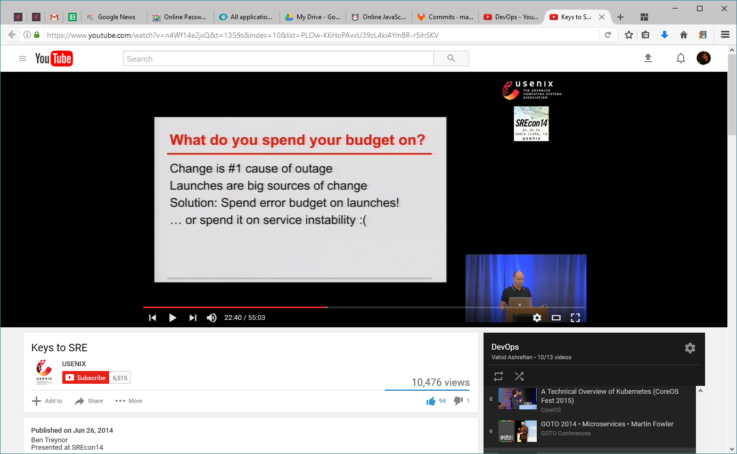
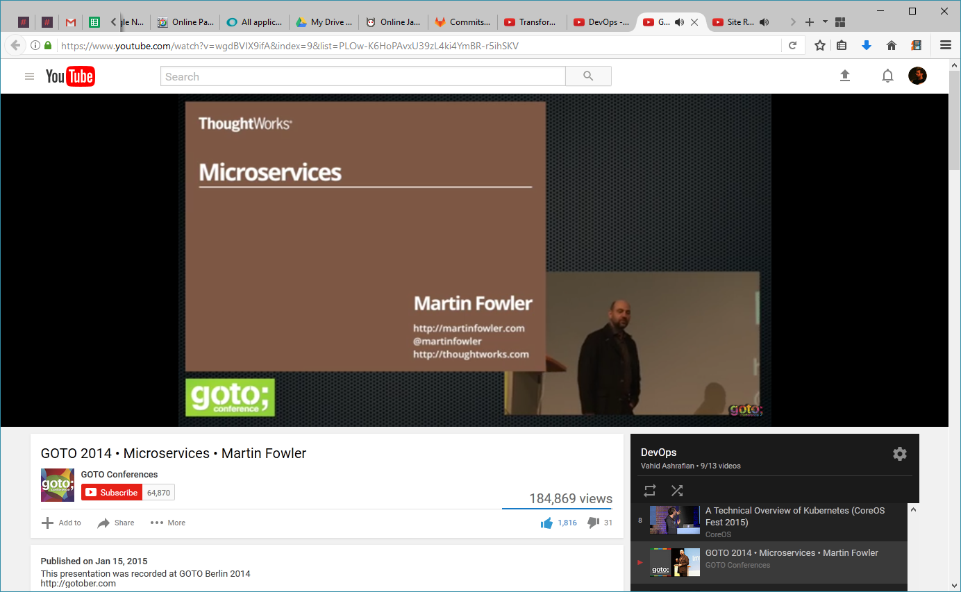

Slide 61
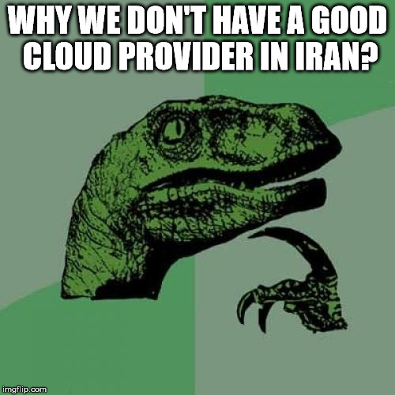
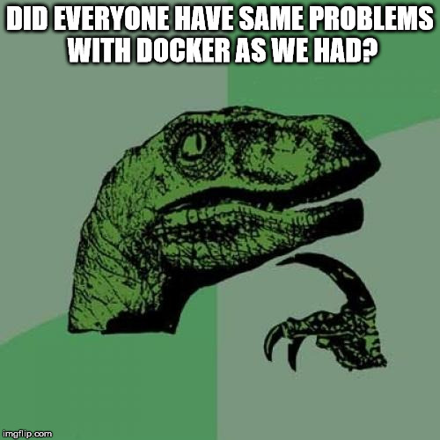



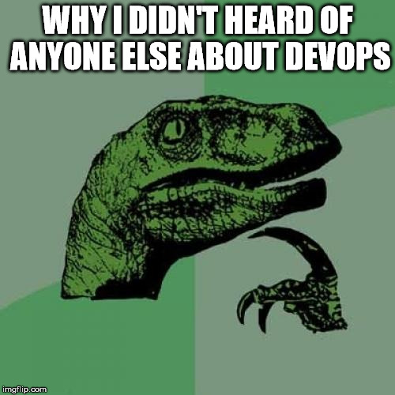

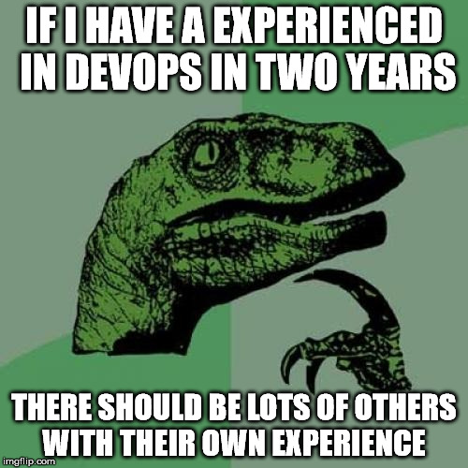

Slide 62

We Need More Stories!

Slide 63



Thank You!
vahid.ashrafian@gmail.com
@vahid_ashrafian
@vahid_ashrafian

Slide 64
Recommended Resources
Introduction to DevOps: Transforming and Improving Operations – edx.org – The Linux Foundation
Spotify Engineering Culture
https://www.youtube.com/watch?v=Mpsn3WaI_4k&list=PLC3mk_XNnmVS7HG_nhNr3I1VQ-2eL2XgB
Transforming Software Development – Amazon Web Services
https://www.youtube.com/watch?v=YCrhemssYuI
My Personal DevOps Playlist on Youtube
https://www.youtube.com/playlist?list=PLOw-K6HoPAvxU39zL4ki4YmBR-r5ihSKV

